Slide 1
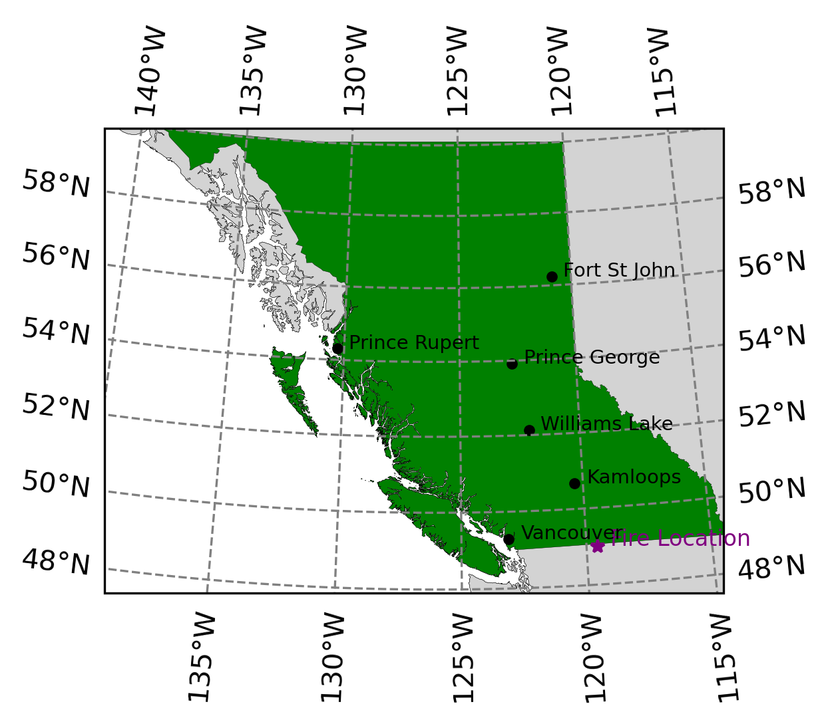
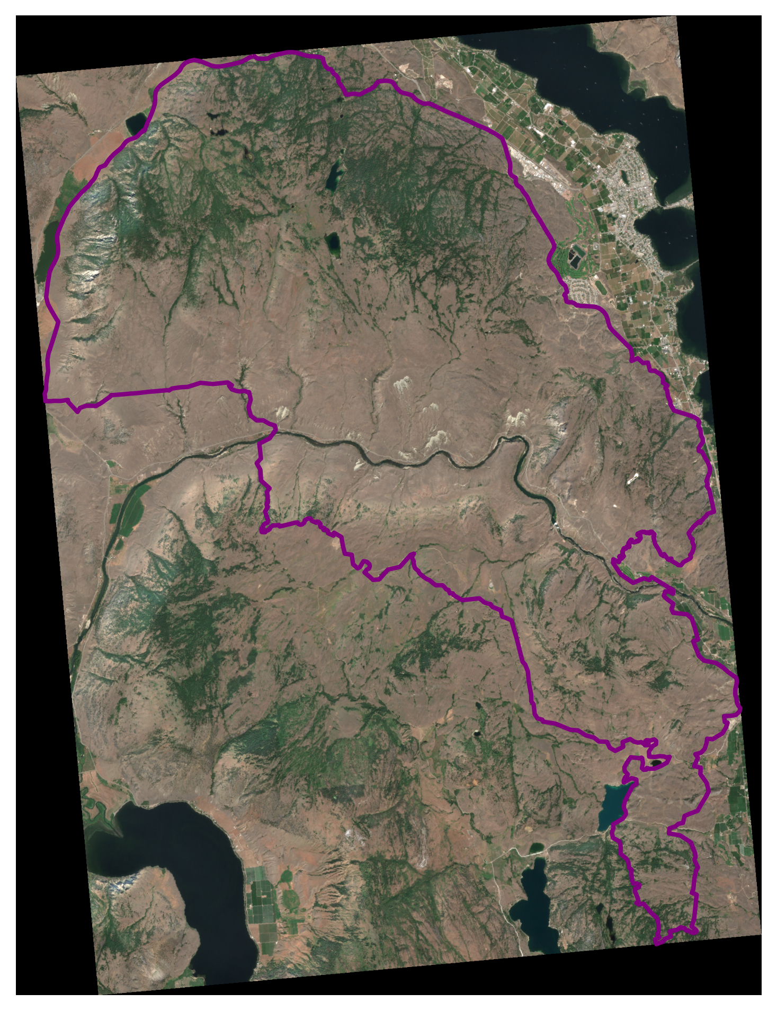
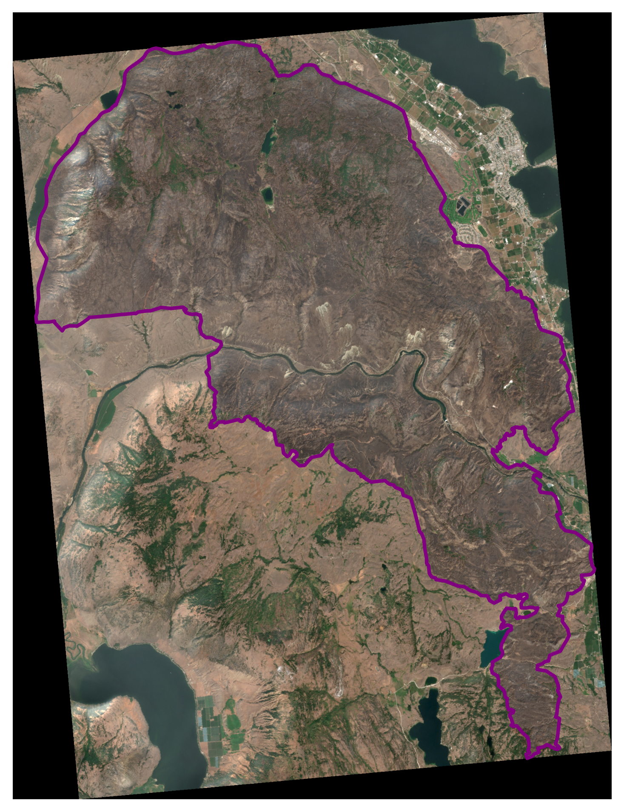
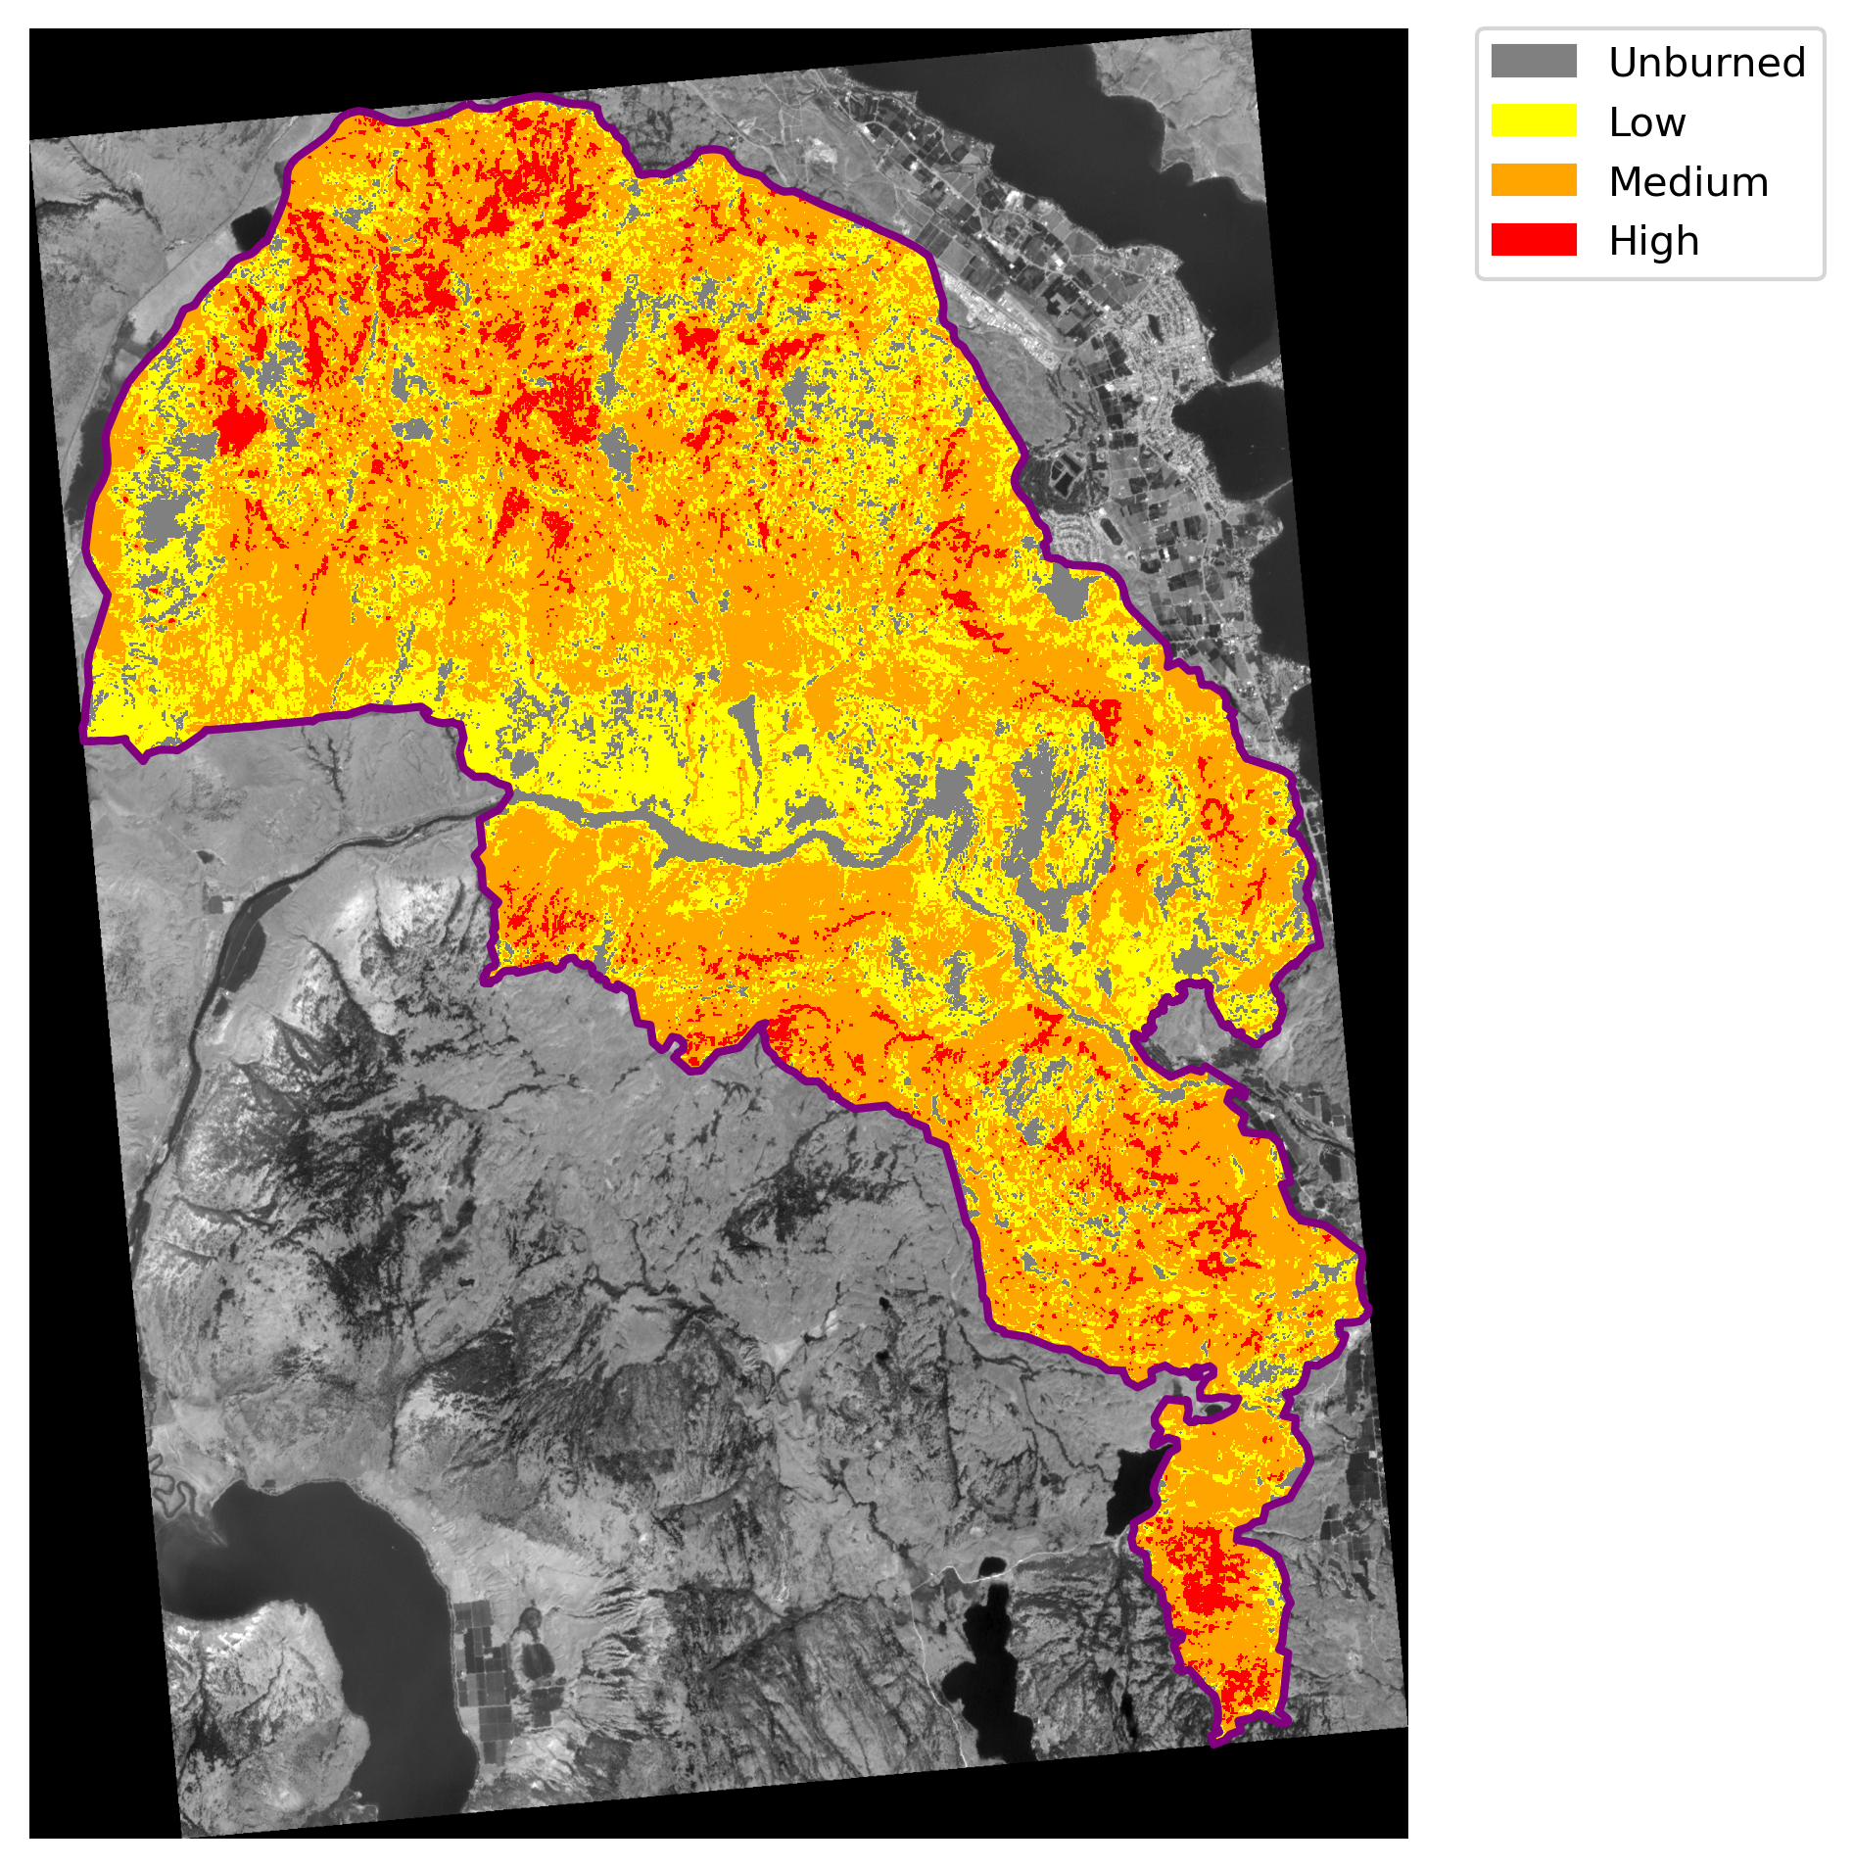
BARC_K52318_20220807_20230827_S2
class | burn_sev | px_count | area_m2 | area_ha | perc
1 | Unburned | 32218 | 12887200.0 | 1288.7 | 9.4
2 | Low | 102728 | 41091200.0 | 4109.1 | 29.9
3 | Medium | 187935 | 75174000.0 | 7517.4 | 54.6
4 | High | 21054 | 8421600.0 | 842.2 | 6.1

Slide 2
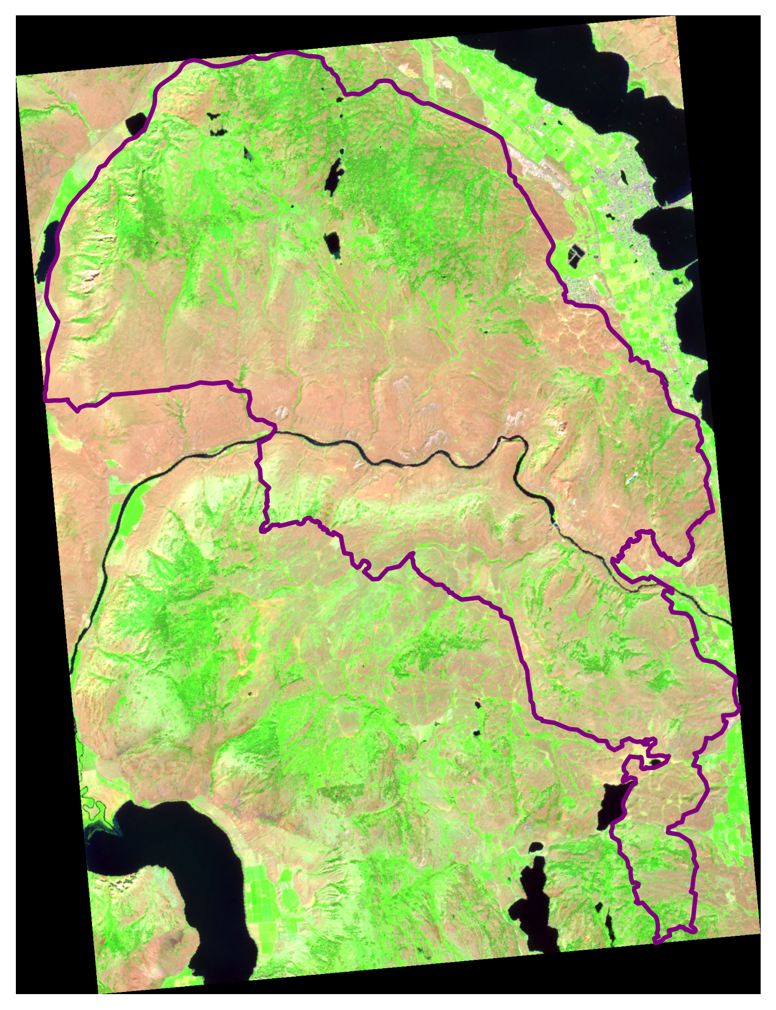
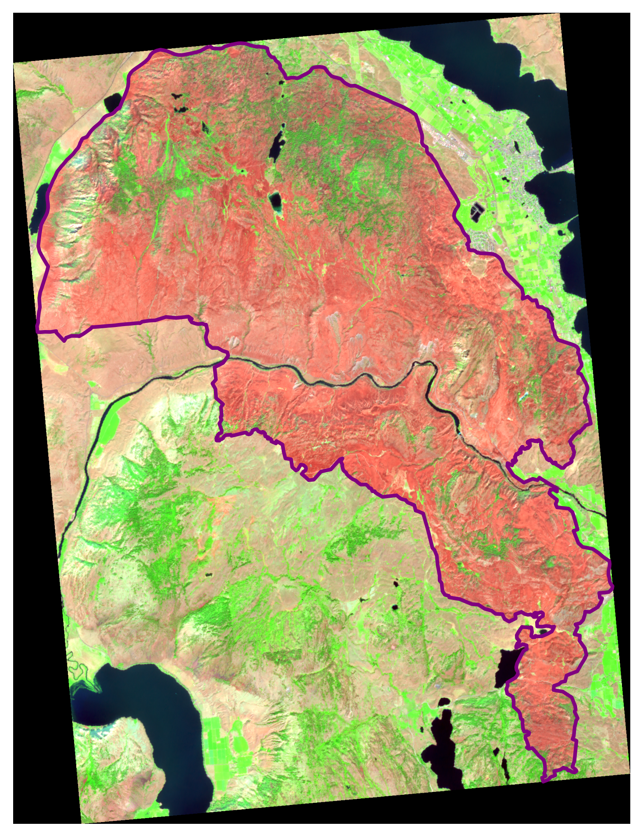
BARC_K52318_20220807_20230827_S2
class | burn_sev | px_count | area_m2 | area_ha | perc
1 | Unburned | 32218 | 12887200.0 | 1288.7 | 9.4
2 | Low | 102728 | 41091200.0 | 4109.1 | 29.9
3 | Medium | 187935 | 75174000.0 | 7517.4 | 54.6
4 | High | 21054 | 8421600.0 | 842.2 | 6.1

